Slide 1
So Far…
It’s time for
Unsupervised learning
We are only given inputs
Goal: find “interesting patterns”
Discovering clusters
Clustering
Discovering latent factors
Dimensionality reduction
Topic modeling
Matrix factorization

Slide 2
Topic Modeling
Deng Cai (蔡登)
College of Computer Science Zhejiang University
dengcai@gmail.com

Slide 3



Topic Modeling
A topic model is a type of statistical model for discovering the latent "topics" that occur in a collection of documents.
Application
Document Generation
Information Retrieval
…

Slide 4
Bag-of-Words (BOW)
Assumes order of words has no significance
e.g., the term “home made” has the same probability as “made home”
It is a simplifying assumption used in natural language processing and information retrieval

Slide 5
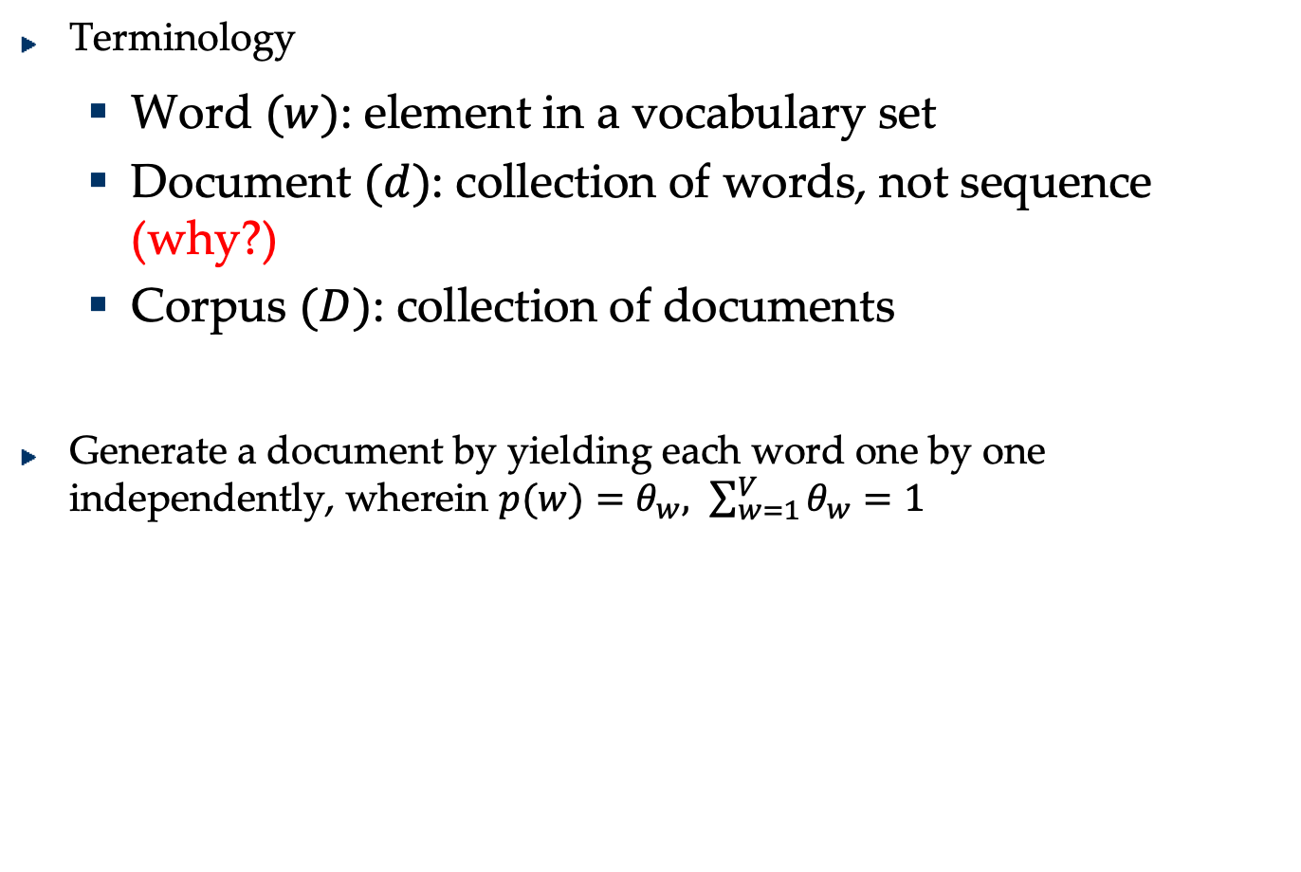
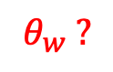
Document Generation
Terminology
Word $(w)$: element in a vocabulary set
Document $(d)$: collection of words, not sequence (why?)
Corpus $(D)$: collection of documents
Generate a document by yielding each word one by one independently, wherein $p(w)=θ_{w}, \sum_{w=1}^{V}{θ_{w}}=1$
$$θ_{w} ?$$
Notes:
A document is a collection of words, not sequence, because of BOW assumption

Slide 6
Unigram Model
Different words appear with different frequency
Example Corpus: Shakespeare’s Literature

Slide 7
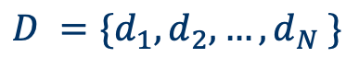
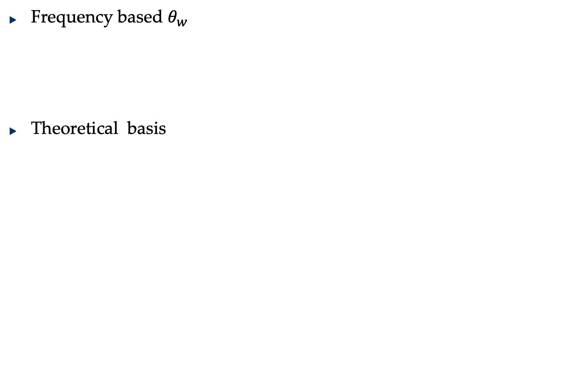
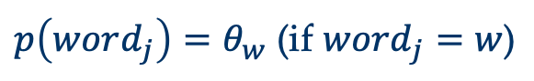
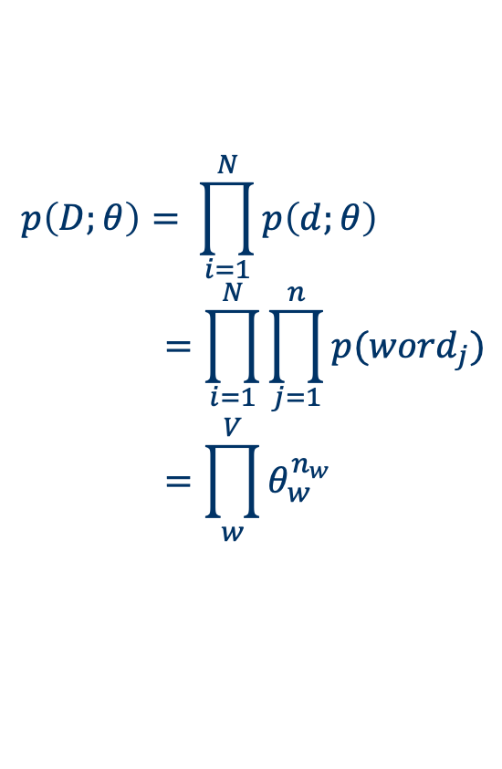
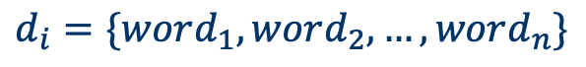
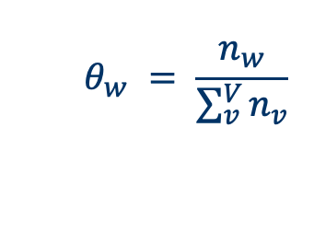
Unigram Model
Frequency based $θ_{w}$
Theoretical basis
Number of appearances of a word in a corpus
$$θ_{w} = \frac{n_{w}}{\sum_{v}^{V}{n_{v}}}$$
$$p\left(D;θ\right)= \prod_{i=1}^{N}{p\left(d;θ\right)} \\ =\prod_{i=1}^{N}{\prod_{j=1}^{n}{p(word_{j})}} \\ =\prod_{w}^{V}{θ_{w}^{n_{w}}}$$
$$d_{i}=\{word_{1},word_{2},…,word_{n}\}$$
$$D =\{d_{1},d_{2},…,d_{N} \}$$
$$p\left(word_{j}\right)=θ_{w} \text{(}\text{if} word_{j}=w\text{)}$$
Notes:
word_j represents the j_th word in a document
‘w’ represents a word in a vocabulary

Slide 8
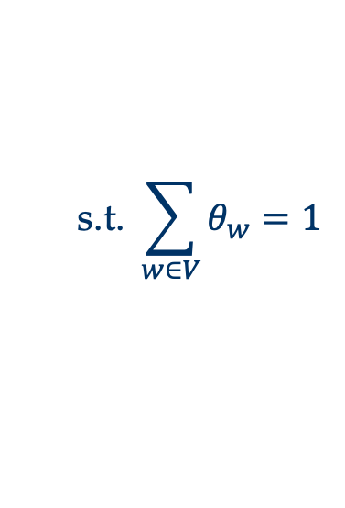
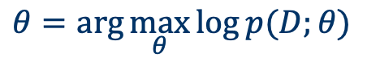
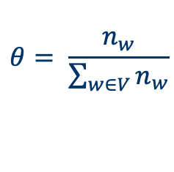
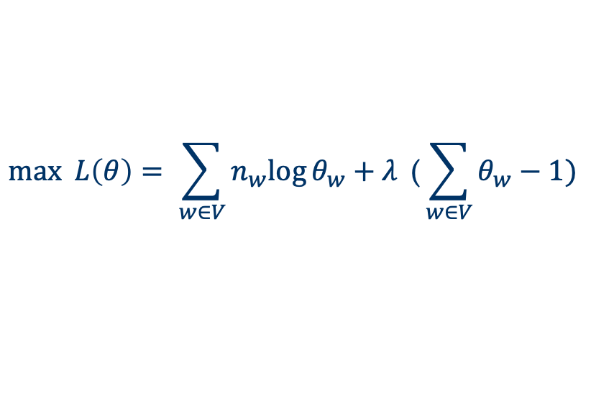
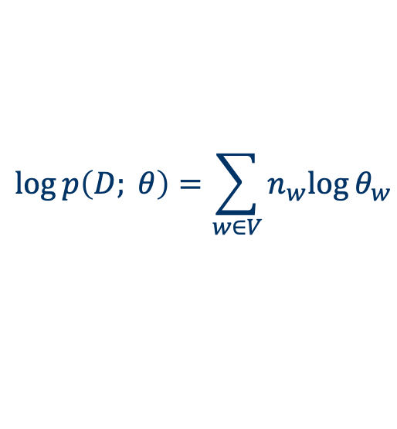
Unigram Model
Maximum Likelihood Estimation
Solved with Lagrange multiplier
$$\log{p\left(D; θ\right)=\sum_{w∈V}{n_{w}log{θ_{w}}}}$$
$$θ=\arg{\max_{θ}{\log{p(D;θ)}}}$$
$$\text{s}\text{.}\text{t}\text{.} \sum_{w∈V}{θ_{w}=1}$$
$$\max{ L\left(θ\right)= \sum_{w∈V}{n_{w}log{θ_{w}+λ}}\text{ (}\sum_{w∈V}{θ_{w}−1})}$$
$$θ= \frac{n_{w}}{\sum_{w∈V}{n_{w}}}$$

Slide 9
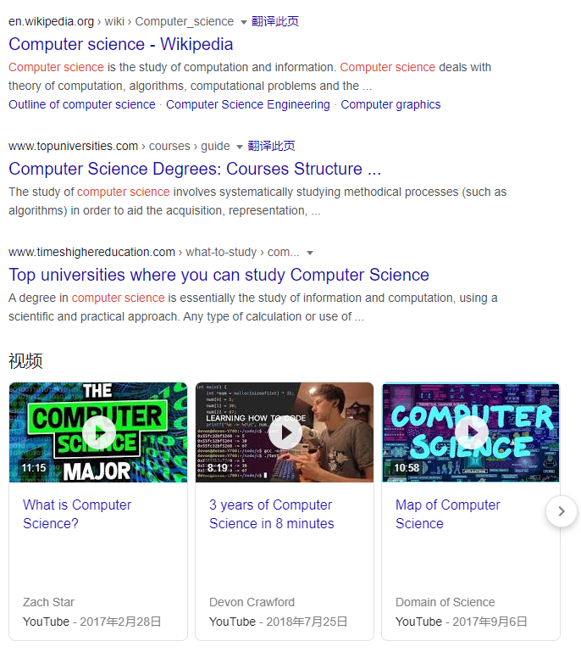
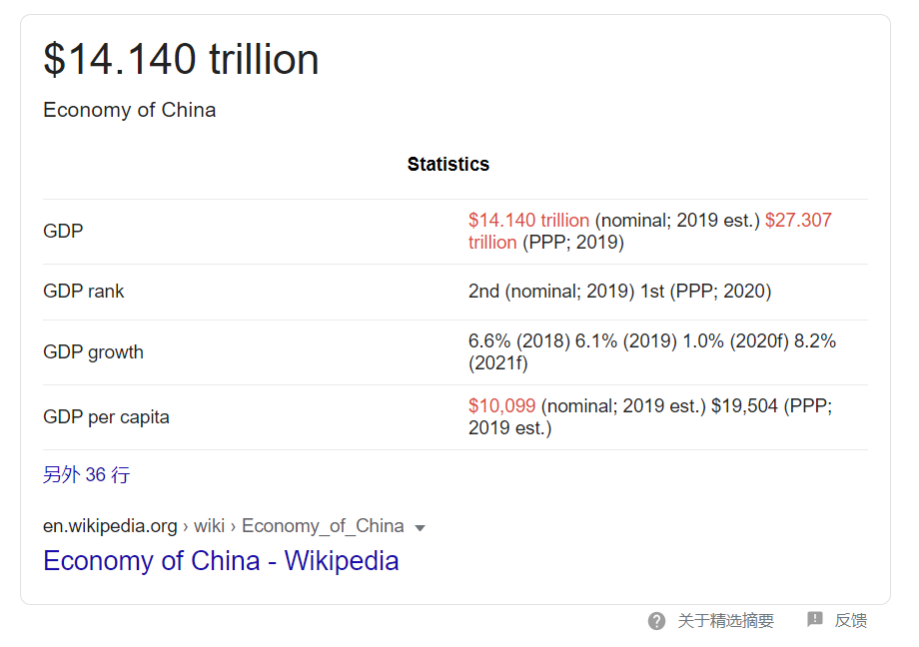
Information Retrieval（IR）
Return the documents relevant to the query
Query = “computer science”
Query=“China GDP 2019”

Slide 10
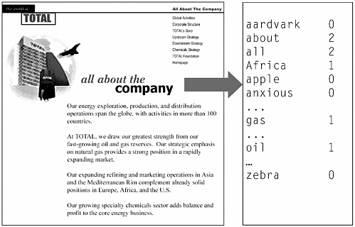
Salton’s Vector Space Model (Prior to 1988)
Represent each document by a high-dimensional vector in the space of words
Notes:
Gerard Salton (8 March 1927 in Nuremberg - 28 August 1995)
Salton was an ACM Fellow (elected 1995), received an Award of Merit from the American Society for Information Science (1989), and was the first recipient of the SIGIR Award for outstanding contributions to study of information retrieval (1983) -- now called the Gerard Salton Award.

Slide 11
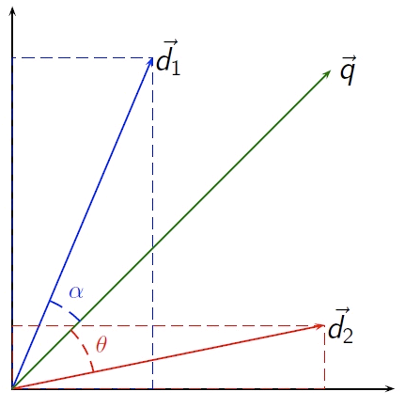
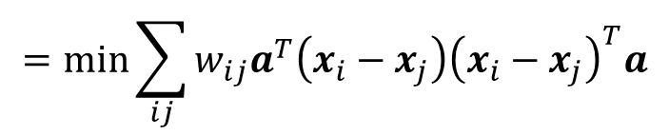
Query
Compute the similarity between queries(q) and documents(d)
$$\cos{(q,d)}=\frac{q^{T}d}{\left\|q\right\|\left\|d\right\|}$$
Simple, intuitive
Fast to compute, because both they are sparse
Retrieval Methods
Rank documents according to similarity with query
Term weighting schemes, for example, TF-IDF

Slide 12
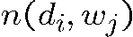
Document-Term Matrix
D = Document collection
W = Lexicon/Vocabulary
intelligence
Texas Instruments said it has developed the first 32-bit computer chip designed specifically for artificial intelligence applications [...]
Document-Term Matrix
intelligence
artificial
interest
artifact
t
=
...
0
1
...
2
0
...
X
term weighting

Slide 13

A 100 Million^{ths} of a Typical Document-Term Matrix
Typical:
Number of documents ≈ 1.000.000
Vocabulary ≈ 100.000
Sparseness < 0.1 %
Fraction depicted ≈ 1e-8
0
1
0
2

Slide 14

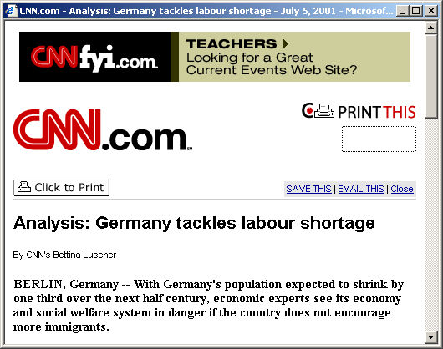



Robust Information Retrieval — Beyond Keyword-based Search
Vocabulary Mismatch Problem
different people using different vocabulary to describe the same concept
matching queries and documents based on keywords is insufficient
“labour immigrants Germany”
“labour immigrants Germany”
query
query
match
match
“German job market for
immigrants”
“German job market for
immigrants”
query
query
?
?
“foreign workers in Germany”
query
“foreign workers in Germany”
query
?
?
query
query
“German green card”
“German green card”
?
?
G. W. Furnas, T. K. Landauer, L. M. Gomez , S. T. Dumais, The Vocabulary Problem in Human-System Communication: an Analysis and a Solution, Bell Communications Research, 1987

Slide 15
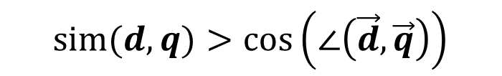
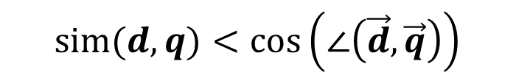
The lost meaning of words
Polysemy: words with multiple meanings
The vector space model is unable to discriminate between different meaning of the same word.
Synonymy: separate words that have the same meaning.
No associations between words are made in the vector space representation
$$\operatorname{sim}{(d,q)}<\cos\left(∠\left(\vec{d},\vec{q}\right)\right)$$
$$\operatorname{sim}{(d,q)}>\cos\left(∠\left(\vec{d},\vec{q}\right)\right)$$
There is a disconnect between topics and words

Slide 16
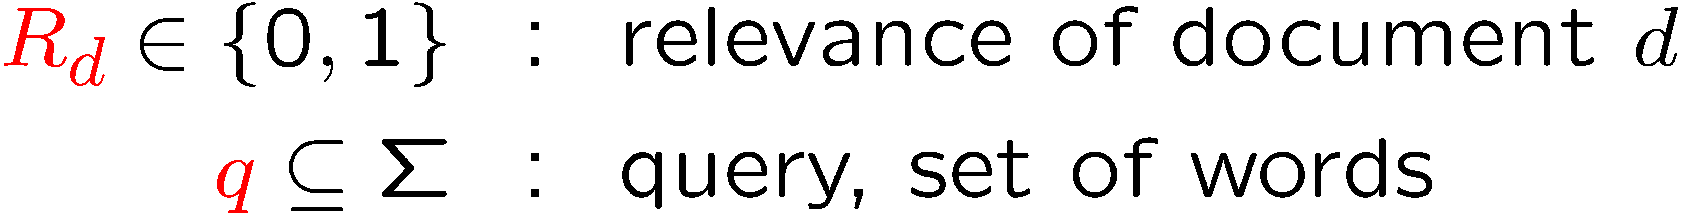
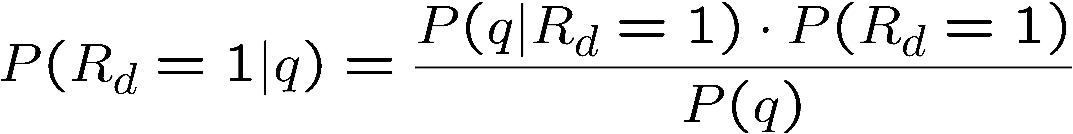
Language Model Paradigm in IR
Probabilistic relevance model
Random variables
Bayes’ rule
probability of generating a query q to ask for relevant d
prior probability of relevance for document d (e.g. quality, popularity)
probability that document d is relevant for query q
J. Ponte and W.B. Croft, A Language Model Approach to Information Retrieval, ACM SIGIR, 1998.

Slide 17
Language Model Paradigm
2
1
1
First contribution: prior probability of relevance
simplest case: uniform (drops out for ranking)
popularity: document usage statistics (e.g. library circulation records, download or access statistics, hyperlink structure)
Second contribution: query likelihood
query terms q are treated as a sample drawn from an (unknown) relevant document
2

Slide 18
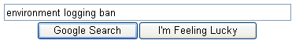


Language Model Paradigm
Query generation model: how might a query look like that would ask for a specific document?
Maron & Kuhns: Indexer manually assigns probabilities for pre-specified set of tags/terms
Ponte & Croft: Statistical estimation problem
Think of a relevant document. Formulate a query by picking some of the keywords as query terms.
Environmentalists are blasting a Bush administration proposal to lift a ban on logging in remote areas of national forests, saying the move ignores popular support for protecting forests.

Slide 19
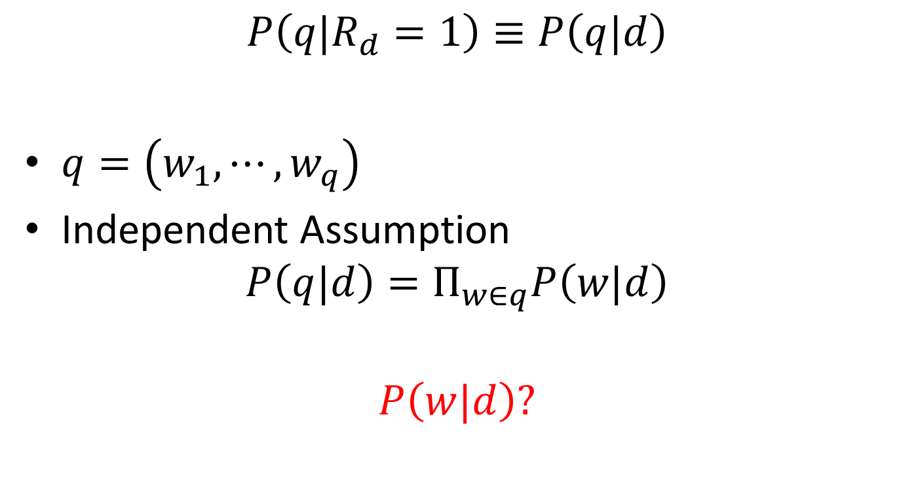
Query Likelihood
$$P\left(q|R_{d}=1\right)≡P\left(q|d\right)$$
$q=\left(w_{1},⋯,w_{q}\right)$
Independent Assumption
$$P\left(q|d\right)=Π_{w∈q}P\left(w|d\right)$$
$$P\left(w|d\right)?$$

Slide 20
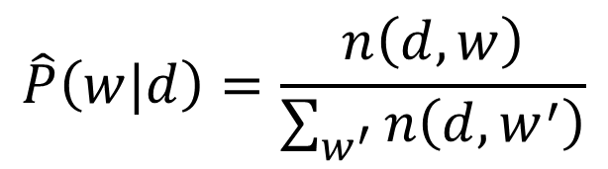
Naive Approach
number of occurrences
of term w in document d
Documents
Terms
$$\hat{P}\left(w|d\right)=\frac{n\left(d,w\right)}{\sum_{w^{′}}{n\left(d,w^{′}\right)}}$$
Zero frequency problem: terms not occurring in a document get zero probability
Maximum Likelihood Estimation

Slide 21
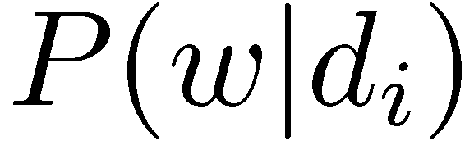
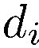
Estimation Problem
(i.i.d) sample
document
estimation
learning from other
documents in a
collection ?
other
documents
Crucial question: In which way can the document collection be utilized to improve probability estimates?

Slide 22
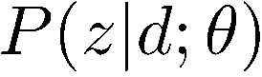
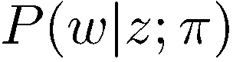
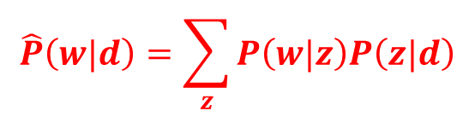
Probabilistic Latent Semantic Analysis
Documents
Terms
$$\hat{P}\left(w|d\right)=\sum_{z}{P\left(w|z\right)P\left(z|d\right)}$$
economic
Concept expression proba-bilities are estimated based on all documents that are dealing with a concept.
imports
TRADE
trade
Latent
Concepts
“Unmixing” of superimposed concepts is achieved by statistical learning algorithm.
T. Hofmann, Probabilistic Latent Semantic Analysis, UAI 1999.

Slide 23
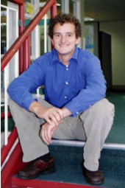
Probabilistic Latent Semantic Analysis
PLSA evolved from Latent semantic analysis, adding a sounder probabilistic model
It was introduced in 1999 by Thomas Hofmann (UAI’99)
It is related to non-negative matrix factorization (NMF)

Slide 24
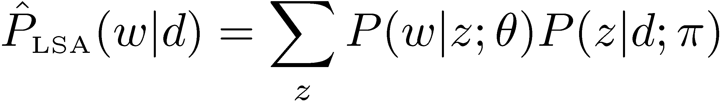
pLSA – Latent Variable Model
Structural modeling assumption (mixture model)
Document
language model
Document-specific
mixture proportions
Latent concepts
or topics
Concept expression
probabilities
Model fitting
T. Hofmann, Probabilistic Latent Semantic Analysis, UAI 1999.

Slide 25
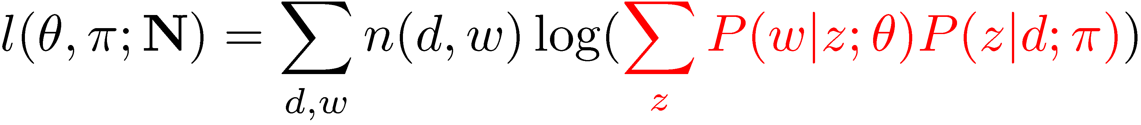
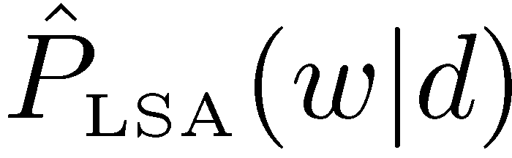
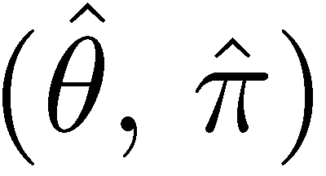
pLSA via Likelihood Maximization
Log-Likelihood
Goal: Find model parameters that maximize the log-likelihood, i.e. maximize the average predictive probability for observed word occurrences (non-convex optimization problem)
argmax
Observed
word frequencies
Predictive probability
of pLSA mixture model
Notes:
$$L=\prod_{i.j}{P{\left(w_{j},d_{i}\right)}^{n\left(w_{j},d_{i}\right)}}$$
Which is to be maximised w.r.t. parameters $P\left(w | z\right)$ and also $P\left(d | z\right)$, subject to the constraints that $\sum_{j=1}^{N}{P\left(w_{j} | z\right)=1}$ and $\sum_{k=1}^{K}{P\left(z_{k} | d\right)=1}$

Slide 26
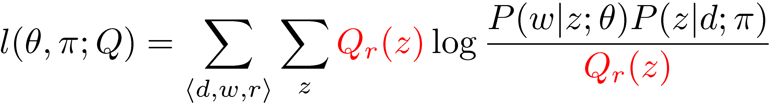
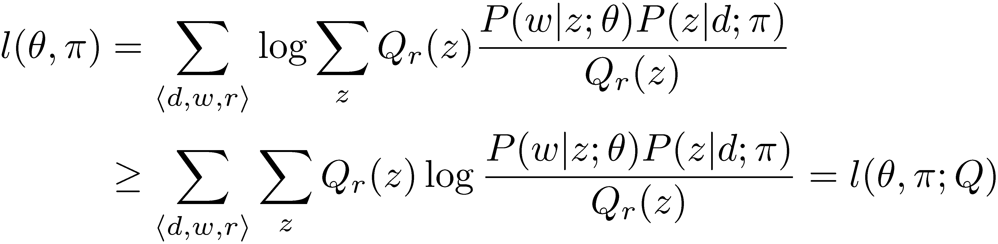
EM Algorithm: Derivation
Q-parameterized lower bound on log-likelihood
Follows from Jensen’s inequality
observed pairs with index r
Q distribution

Slide 27
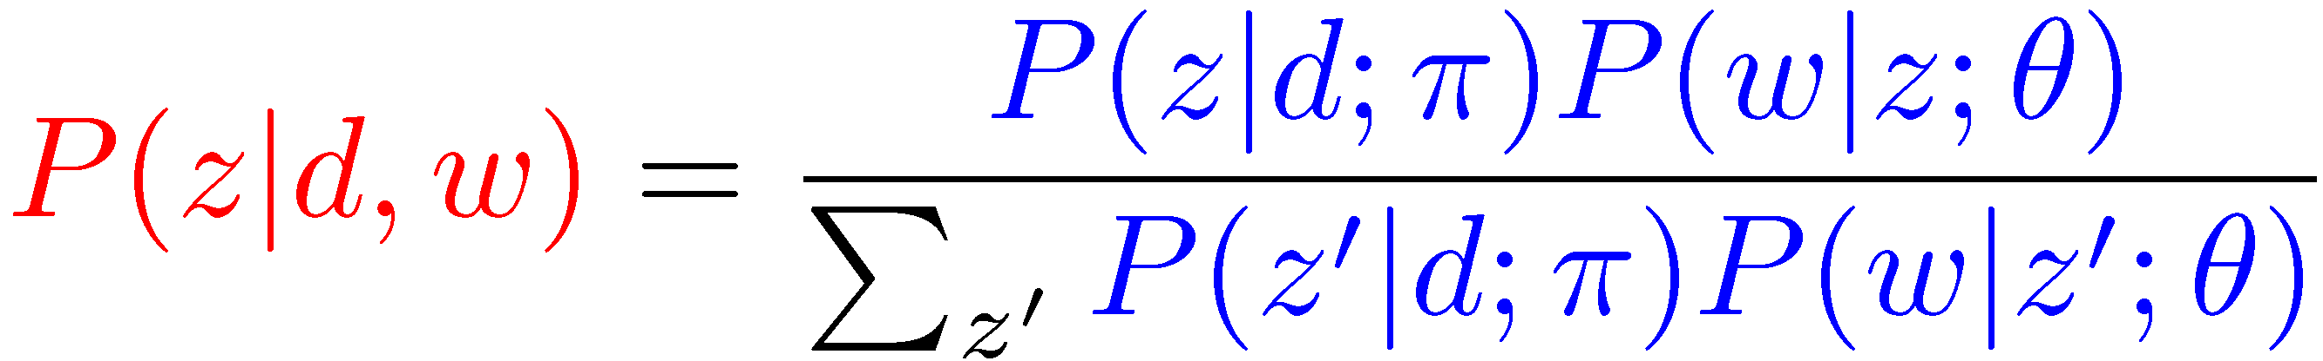
Expectation Maximization Algorithm
E step: posterior probability of latent variables (“concepts”)
Probability that the occurence of term w in document d can be “explained“ by concept z
M step: parameter estimation based on “completed” statistics
how often is term w associated with concept z ?
how often is document d associated with concept z ?
A.P. Dempster, N.M. Laird, and D.B. Rubin, Maximum Likelihood from Incomplete Data via the EM Algorithm, Journal of Royal Statistical Society B, vol. 39, no. 1, pp. 1-38, 1977

Slide 28
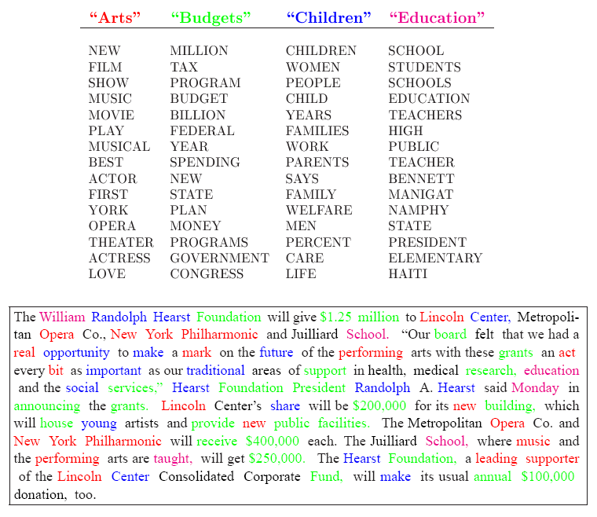
$P\left(w | z\right)$ Matrix

Slide 29
Variations of pLSA
Hierarchical extensions:
Asymmetric: MASHA ("Multinomial Asymmetric Hierarchical Analysis")
Symmetric: HPLSA ("Hierarchical Probabilistic Latent Semantic Analysis")
Manifold regularizer:
Probabilistic Dyadic Data Analysis with Local and Global Consistency
Generative models:
Latent Dirichlet allocation - adds a Dirichlet prior on the per-document topic distribution, trying to address an often-criticized shortcoming of PLSA, namely that it is not a proper generative model for new documents and at the same time avoid the overfitting problem.

